Slide 1

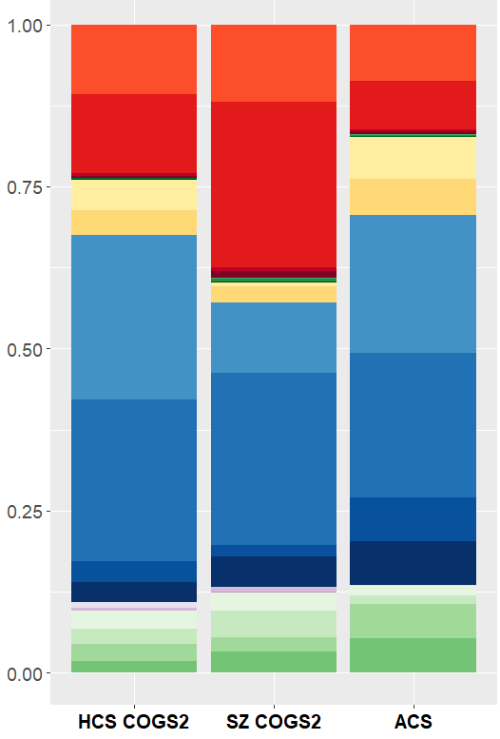
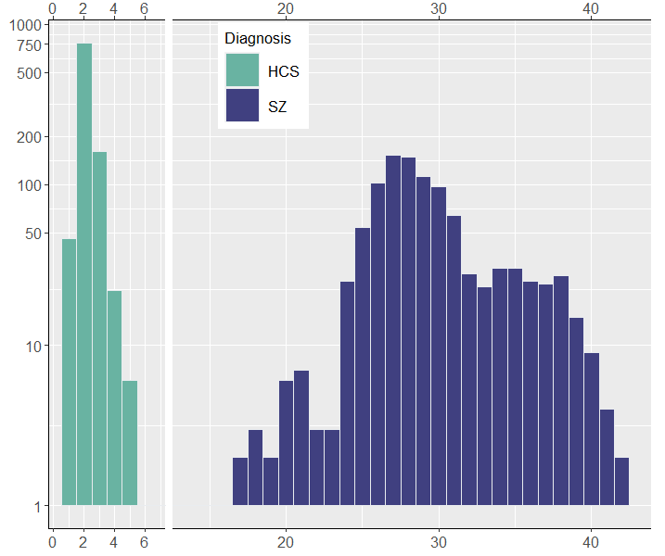
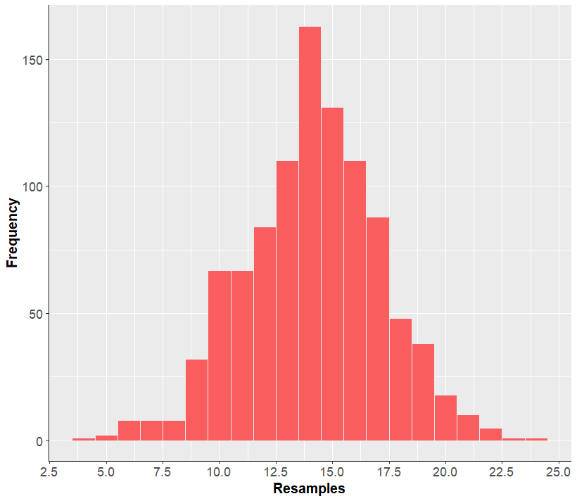
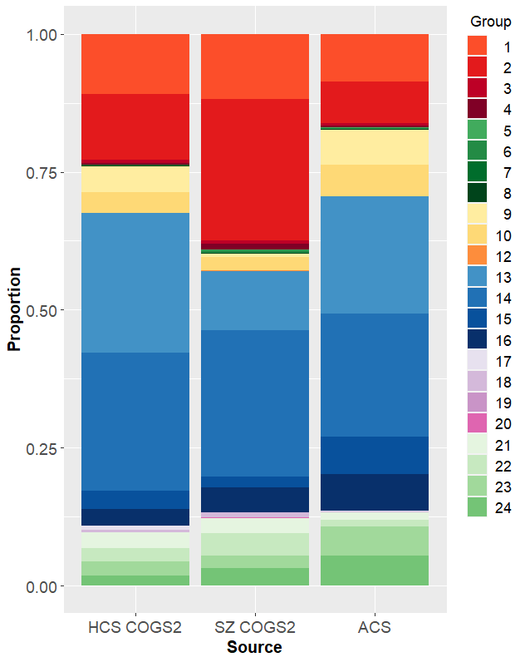
Background
#1. Comparison of COGS2 and ACS Demographics
W 182. How diverse are large multi-site schizophrenia studies? Modelling race, ethnicity and gender parity in COGS2
We report a new way to conceptualize race, ethnicity and gender parity in large studies of schizophrenia.
TAKE HOME POINT
Race, ethnicity, and gender disparities in recruitment of patients with schizophrenia (SZ) may create issues with generalizability.
We report on race, ethnicity and gender diversity in the Consortium on the Genetics of Schizophrenia 2 (COGS2) study, and quantify the extent of sampling necessary to achieve racial, ethnicity, and gender parity.
1062 healthy control subjects (HCS) and 1415 schizophrenia (SZ) subjects from the five COGS2 sites were recruited: Los Angeles, New York, Philadelphia, San Diego, and Seattle.
Subjects were categorized into 24 categories based on combinations of 6 races, Hispanic/Latino or non-Hispanic/Latino status (H/L), and self-reported male/female sex disclosed at study entry.
Demographic proportions were compared to age-matched American Community Survey (ACS) census data for each of the above cities from 2010-2014; p-values from binomial comparisons were Holm-adjusted for multiple comparisons.
Composition of HCS and
SZ subjects per site was:
A Fisher’s Exact Test was used to determine whether HCS and SZ proportions that were both significantly different from ACS were also significantly different from each other.
We then ran a simulation algorithm which sequentially expanded the HCS and SZ cohorts by 50% by randomly resampling from the already recruited cohort, excluding subjects who were already oversampled in COGS2 based on ACS data.
The algorithm was allowed to resample until all 24 category proportions were within 2.5% of ACS data, and simulations were repeated 1,000 times. The same algorithm was applied to characterize the demographic differences between SZ and HCS samples within COGS2.
Methods
#2. Simulation Results
a)
b)
c)
d)
Median number of resamples to achieve convergence for HCS: 2.0
Median number of resamples to achieve convergence from SZ to HCS: 14.5
Median number of resamples to achieve convergence for SZ: 28.5
Proportion
Number of Simulations
Number of Simulations
Number of Resamples
Number of Resamples
a) Figure shows demographic composition of the COGS2 Healthy Control (HCS) and Schizophrenia (SZ) samples compared to American Community Survey (ACS).
b) Table shows hypothesis testing for demographic proportions from COGS2 samples compared with demographic proportions from ACS. The Trend column describes whether the COGS2 proportion for a demographic group was significantly higher or lower for the corresponding demographic from ACS. Boldfaced p-values indicate p < 0.05. Asterisks indicate demographic proportions between SZ and HCS were significantly different with p < 0.05.
c) Number of full resamples required to achieve convergence between COGS2 samples and ACS. The number of full resamples is equal to the number of 50% resamples divided by two. The median factor of expansion required to achieve convergence is calculated by adding one to the median number of resamples.
d) Sequential expansion of SZ to match HCS demographic proportions within 2.5%. Histogram documents number of full resamples required to converge from SZ to HCS.
References
This data highlights the extent to which both HCS and SZ subjects from COGS2 differ in demographic composition compared to the city populations in which they are recruited as well as the extent of demographic difference between HCS and SZ subjects within COGS2.
COGS2 would need to be expanded by a median factor of >3 for HCS and >29.5 for SZ to achieve representative racial, ethnic, and gender diversity. Convergence between SZ and HCS required a median expansion factor of >15.5, suggesting that within COGS2, the SZ sample was more closely related to HCS than the corresponding ACS population.
Ongoing analyses will investigate whether primary outcomes in COGS2 would be altered in simulated cohorts which are adequately diverse. Our findings emphasize the need for nuanced and targeted approaches for recruitment in large SZ multi-site studies.
Steven Ruggles, Sarah Flood, Matthew Sobek, Danika Brockman, Grace Cooper, Stephanie Richards, and Megan Schouweiler. IPUMS USA: Version 13.0 [dataset]. Minneapolis, MN: IPUMS, 2023. https://doi.org/10.18128/D010.V13.0
Yash B. Joshi, Daniel E. Zoleikhaeian, Juan L. Molina, COGS2 Investigators, David L. Braff, Neal R. Swerdlow, Gregory A. Light
Discussion
Swerdlow NR, Light GA, Sprock J, Calkins ME, Green MF, Greenwood TA, Gur RE, Gur RC, Lazzeroni LC, Nuechterlein KH, Radant AD, Ray A, Seidman LJ, Siever LJ, Silverman JM, Stone WS, Sugar CA, Tsuang DW, Tsuang MT, Turetsky BI, Braff DL. Deficient prepulse inhibition in schizophrenia detected by the multi-site COGS. Schizophr Res. 2014 Feb;152(2-3):503-12. doi: 10.1016/j.schres.2013.12.004. Epub 2014 Jan 7. PMID: 24405980; PMCID: PMC3960985.

